Slide 1
Actual vs Forecast Sales Trends (Jan-Jun 2025)
Analyzing performance against predicted outcomes in first half
Notes:
---

Slide 2
Sales Trends Overview
Notes:
Actual vs Forecast Sales Analysis

Slide 3
Actual vs Forecast Sales Analysis
Date | Scenario | Sales
1/1/2025 | Actual | 120
2/1/2025 | Actual | 150
3/1/2025 | Actual | 135
4/1/2025 | Actual | 180
5/1/2025 | Actual | 210
6/1/2025 | Actual | 195
1/1/2025 | Forecast | 220
2/1/2025 | Forecast | 240
3/1/2025 | Forecast | 230
4/1/2025 | Forecast | 260
5/1/2025 | Forecast | 280
6/1/2025 | Forecast | 300
Notes:
The analysis of Actual versus Forecast sales trends for the first half of 2025 provides valuable insights into performance and projections. Actual sales began at 120 units in January and showed a steady increase through May, peaking at 210 units before experiencing a slight decline to 195 units in June. This pattern suggests strong growth during the spring months, followed by a minor slowdown as summer approached. In contrast, forecasted sales consistently projected higher figures, starting at 220 units in January and climbing steadily to 300 units by June. The widening gap between actual and forecasted sales over time indicates that while the business anticipated aggressive growth, actual performance fell short of expectations. This discrepancy could be attributed to various factors such as market conditions, supply chain challenges, or changes in consumer demand. Understanding these trends is critical for refining future forecasts and adjusting operational strategies. The consistent upward trajectory in forecasts highlights optimism in planning, but the divergence from actual results underscores the need for more accurate predictive models and responsive business tactics. By closely monitoring these patterns, organizations can identify areas for improvement, enhance forecasting accuracy, and implement corrective measures to align performance with strategic goals.

Slide 4
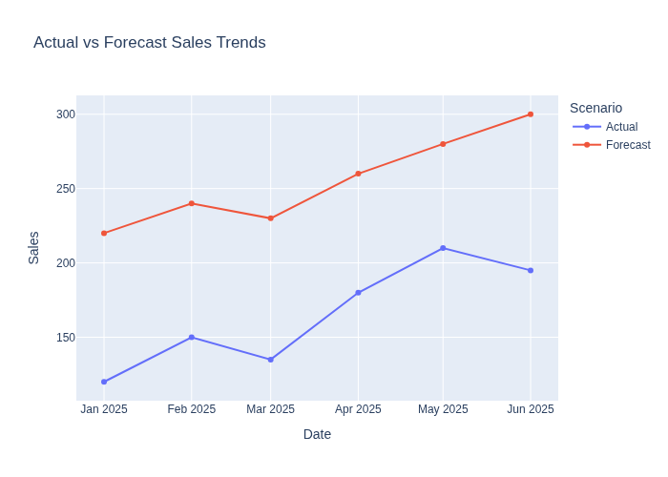
Key Insights
Actual sales consistently trailed forecasted sales each month.
The gap between actual and forecasted sales widened over time, with the largest shortfall in June (actual: 195 vs. forecast: 300).
Actual sales peaked in May, then declined slightly in June, while forecasts projected continued growth.
This suggests that forecasts were optimistic and actual performance did not keep pace, possibly due to market or operational challenges.

